Slide 1
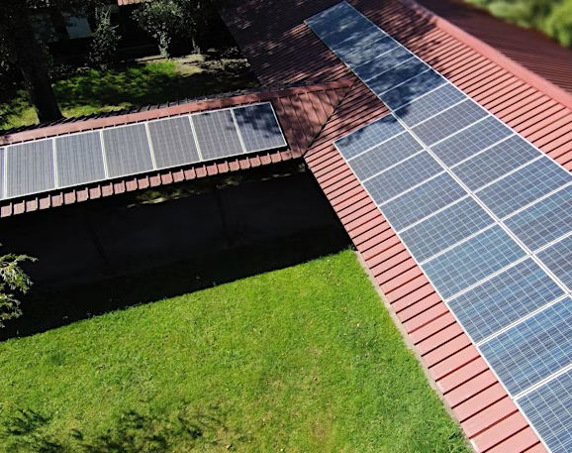

Webinar for the IEEE PES GM 2025 Energy Forecast Competition
Webinar 23 June
Luis Gomes (log@isep.ipp.pt)

Slide 2

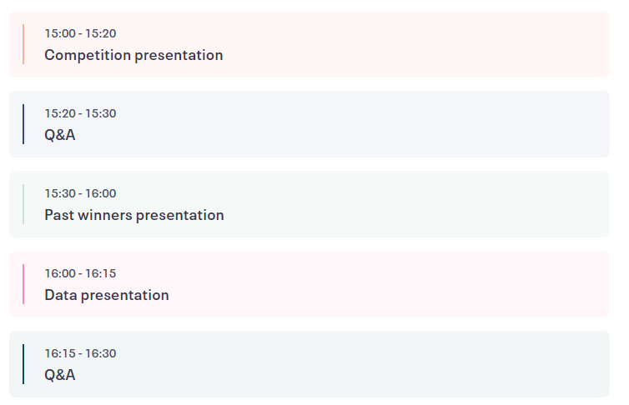
Agenda

Slide 3

Competition Outline goals
Accurate Forecasting: Participants must forecast hourly electric energy consumption
Multi-criteria Evaluation: Methods are judged not only by accuracy (using RMSE)
Focus on Methodology: Pre-processing techniques can be crucial

Slide 4
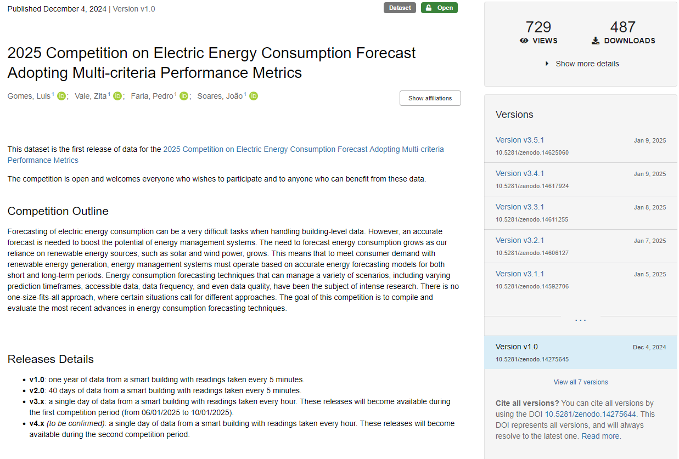
Competition Outline data
1 week competition, with daily submissions
Data will be published, to participants and to the public, every day
https://zenodo.org/records/14275645

Slide 5

Competition Outline submission
By email, until 22:59 GMT
  log@isep.ipp.pt, zav@isep.ipp.pt, pnf@isep.ipp.pt, and jan@isep.ipp.pt
Each submission must include
  the results obtained for that day
  the execution time
  (optional) execution energy consumption
  the code used to generate the results (equal in all submission days)
  a simple readme to describe how the code can be executed (equal in all submission days)
  the description of the forecast model used (equal in all submission days)
  declaration of authorship (equal in all submission days)

Slide 6

Competition Outline
results
Daily releases (during week competition)
  forecasted weather temperature for next day (hourly)
  real consumption of the previous day (hourly)
  The results will be evaluated according to
  Root mean square error (RMSE)
  Execution time
  (optional) Energy consumption

Slide 7
Deadlines
1 December 2024: release of v1.0 data (1 year data
30 December 2024: release of v2.0 data (40 days data)
05-10 January 2025: first week of competition
23 June 2025: Webinar
14 July 2025: second week of competition!
27-31 July 2025 (IEEE PES GM 25): Winners announced

Slide 8

REGISTRATION IS
MANDATORY!!

Slide 9





Team
Luis Gomes: log@isep.ipp.pt
Pedro Faria: pnf@isep.ipp.pt
João Soares: jan@isep.ipp.pt
Zita Vale: zav@isep.ipp.pt

Slide 10

Time for

Slide 11
Webinar for the IEEE PES GM 2025 Energy Forecast Competition
Webinar 23 June
Luis Gomes (log@isep.ipp.pt)

