Slide 1
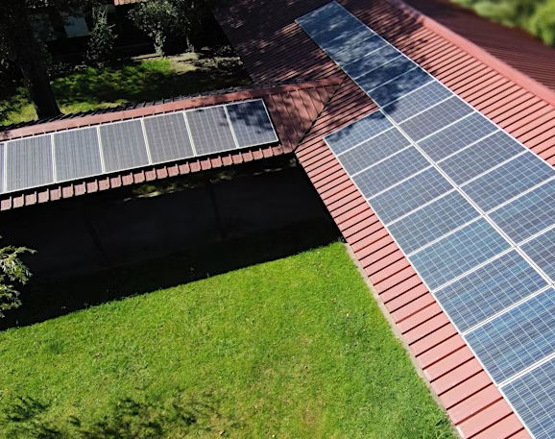

Webinar for the IEEE PES GM 2025 Energy Forecast Competition
Webinar 23 June
Luis Gomes (log@isep.ipp.pt)

Slide 2

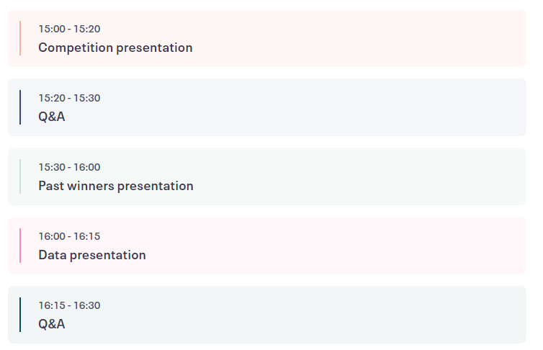
Agenda

Slide 3

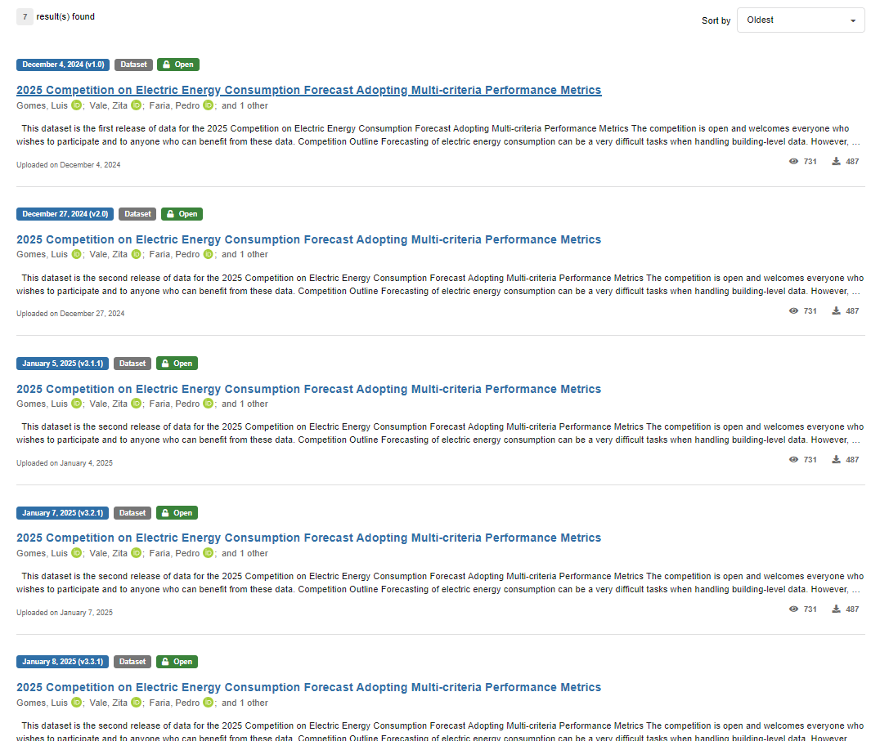
Dataset versions
https://zenodo.org/search?q=parent.id%3A14275644&f=allversions%3Atrue&l=list&p=1&s=10&sort=oldest

Slide 4
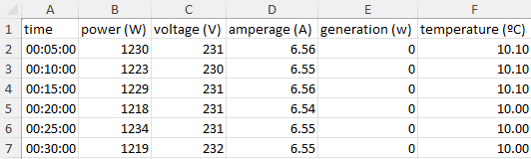
Dataset v1.0
https://zenodo.org/records/14275645
Excel file
Dataset Description
  Time: in hours and minutes
  Power: in Watts
  Voltage: in Volts
  Current: in Amperes
  Generation power: in Watts
  Temperature: in ºC

Slide 5
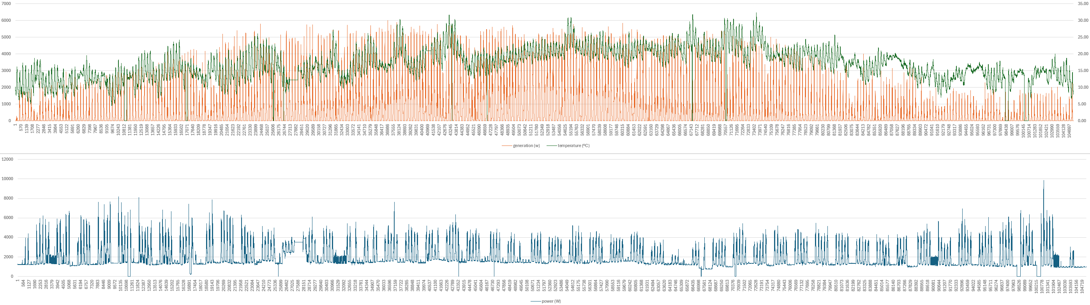
Dataset v1.0
https://zenodo.org/records/14275645
Real data with real issues

Slide 6
Dataset v1.0
https://zenodo.org/records/14275645
Real data with real issues

Slide 7
Dataset v3.3.1
https://zenodo.org/records/14611255
Two files
  data_v3.2.2_real comsumption_day 2.xlsx
  data_v3.3.1_weather forecast_day 3.xlsx

Slide 8
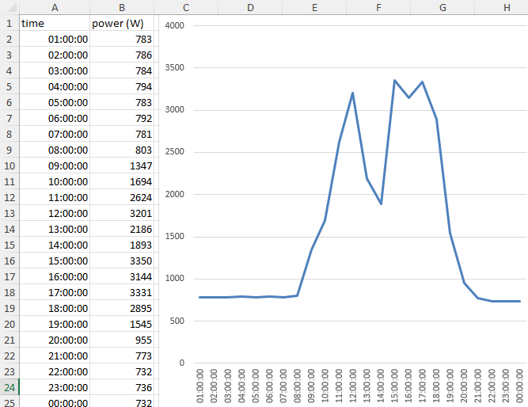
Dataset v3.3.1
https://zenodo.org/records/14611255
Two files
  data_v3.2.2_real comsumption_day 2.xlsx
  data_v3.3.1_weather forecast_day 3.xlsx

Slide 9
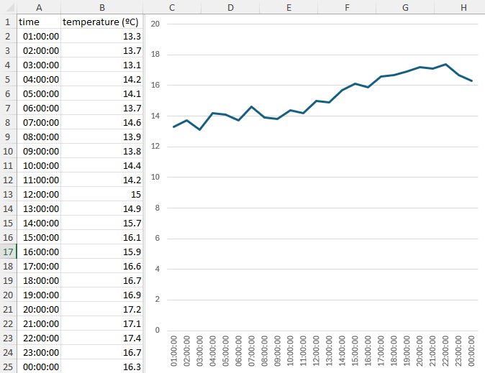
Dataset v3.3.1
https://zenodo.org/records/14611255
Two files
  data_v3.2.2_real comsumption_day 2.xlsx
  data_v3.3.1_weather forecast_day 3.xlsx

Slide 10
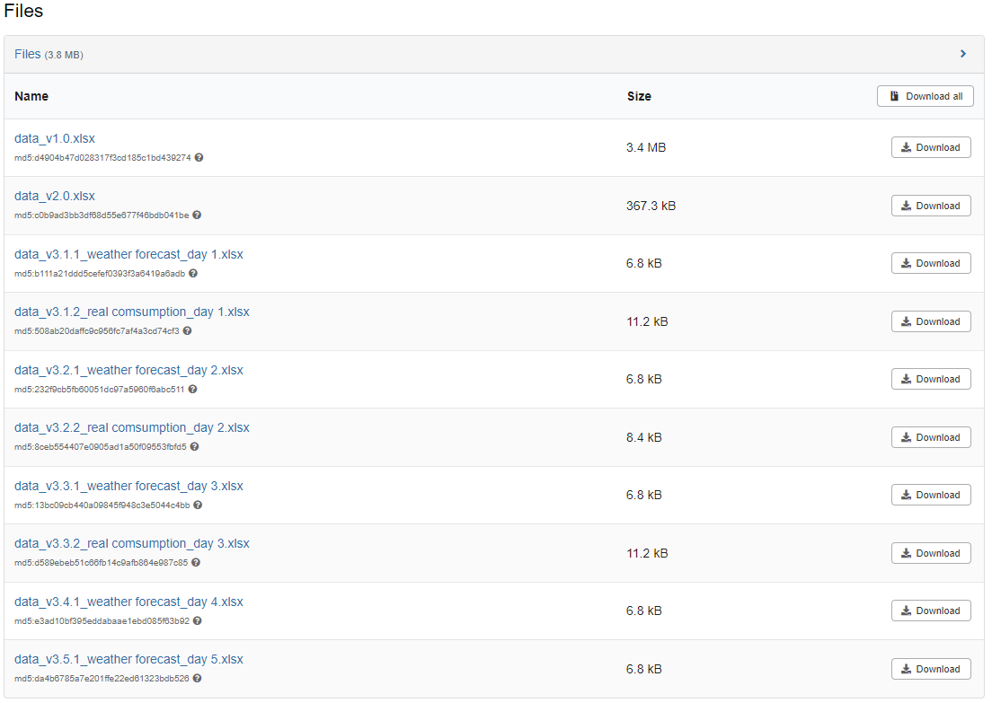
Dataset v3.5.1
https://zenodo.org/records/14625060

Slide 11

Time for

Slide 12
Webinar for the IEEE PES GM 2025 Energy Forecast Competition
Webinar 23 June
Luis Gomes (log@isep.ipp.pt)

